Slide 1

Instrumentation and Control
CSE 325
Still climbing after knowledge infinite, And always moving as the restless spheres
-Tamburlaine The Great by Christopher Marlowe
Mehedi Hasan
Lecturer
Computer Science and Engineering(CSE)
Daffodil International University(DIU)

Slide 2
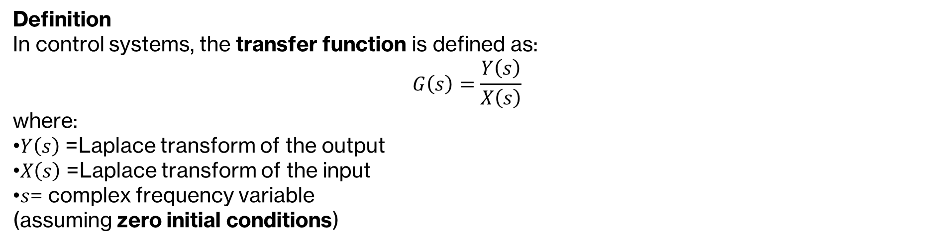
The Transfer Function
A transfer function is a mathematical way to describe how a control system transforms an input into an output.
Definition
In control systems, the transfer function is defined as:
$$G\left(s\right)=\frac{Y\left(s\right)}{X\left(s\right)}$$
where:
$Y\left(s\right)$= Laplace transform of the output
$X\left(s\right)$= Laplace transform of the input
$s$= complex frequency variable (assuming zero initial conditions)
Knowledge that you have to remember:
Laplace Transform of Differentiation
If L{f(t)} = F(s)
First derivative: L{ df(t)/dt } = sF(s) − f(0)2)
Second derivative: L{ d²f(t)/dt² } = s²F(s) − s f(0) − f’(0)
nth derivative: L{ dⁿf(t)/dtⁿ } = sⁿF(s) − sⁿ⁻¹ f(0) − sⁿ⁻² f'(0) − ... − f⁽ⁿ⁻¹⁾(0)
Under zero initial conditions: L{ df(t)/dt } = sF(s)
L{ d²f(t)/dt² } = s²F(s)
L{ dⁿf(t)/dtⁿ } = sⁿF(s)

Slide 3
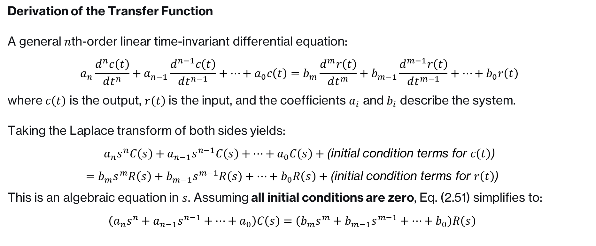
The Transfer Function
Derivation of the Transfer Function
A general $n$th-order linear time-invariant differential equation:
$$a_{n}\frac{d^{n}c\left(t\right)}{dt^{n}}+a_{n−1}\frac{d^{n−1}c\left(t\right)}{dt^{n−1}}+⋯+a_{0}c\left(t\right)=b_{m}\frac{d^{m}r\left(t\right)}{dt^{m}}+b_{m−1}\frac{d^{m−1}r\left(t\right)}{dt^{m−1}}+⋯+b_{0}r\left(t\right)$$
where $c\left(t\right)$ is the output, $r\left(t\right)$ is the input, and the coefficients $a_{i}$ and $b_{i}$ describe the system.
Taking the Laplace transform of both sides yields:
$$a_{n}s^{n}C\left(s\right)+a_{n−1}s^{n−1}C\left(s\right)+⋯+a_{0}C\left(s\right)+\text{(}\text{initial} \text{condition} \text{terms} \text{for} c\left(t\right)\text{)}$$
$$\begin{matrix} & =b_{m}s^{m}R\left(s\right)+b_{m−1}s^{m−1}R\left(s\right)+⋯+b_{0}R\left(s\right)+\text{(}\text{initial} \text{condition} \text{terms} \text{for} r\left(t\right)\text{)} & & \end{matrix}$$
This is an algebraic equation in $s$. Assuming all initial conditions are zero, Eq. (2.51) simplifies to:
$$\begin{matrix} & \left(a_{n}s^{n}+a_{n−1}s^{n−1}+⋯+a_{0}\right)C\left(s\right)=\left(b_{m}s^{m}+b_{m−1}s^{m−1}+⋯+b_{0}\right)R\left(s\right) & & \end{matrix}$$

Slide 4


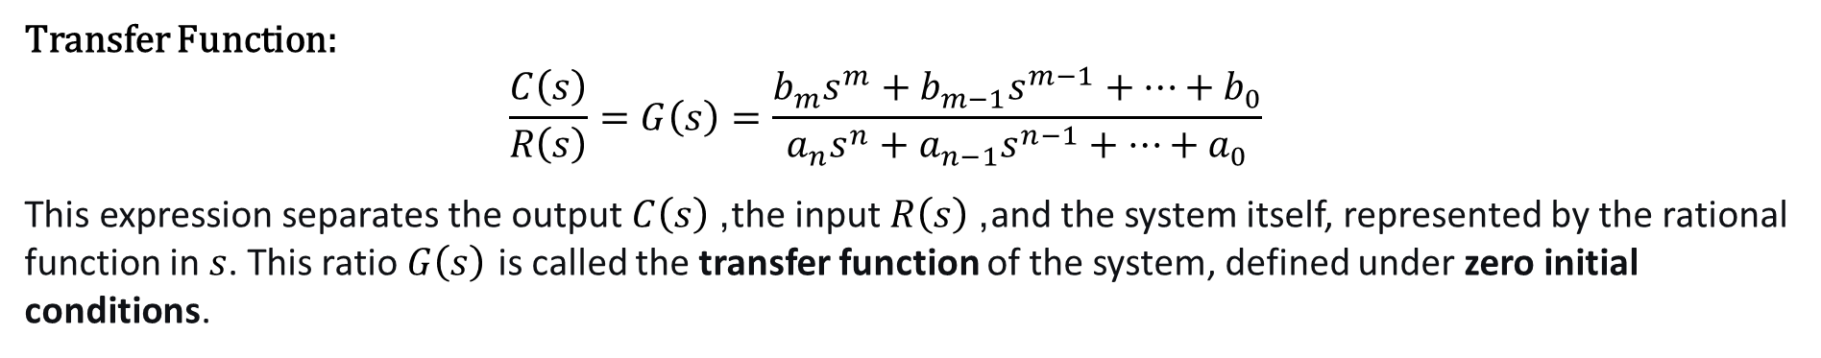
The Transfer Function
Transfer Function:
$$\begin{matrix} & \frac{C\left(s\right)}{R\left(s\right)}=G\left(s\right)=\frac{b_{m}s^{m}+b_{m−1}s^{m−1}+⋯+b_{0}}{a_{n}s^{n}+a_{n−1}s^{n−1}+⋯+a_{0}} & & \end{matrix}$$
This expression separates the output $C\left(s\right)$, the input $R\left(s\right)$, and the system itself, represented by the rational function in $s$. This ratio $G\left(s\right)$ is called the transfer function of the system, defined under zero initial conditions.
The output, C(s) by using

Slide 5
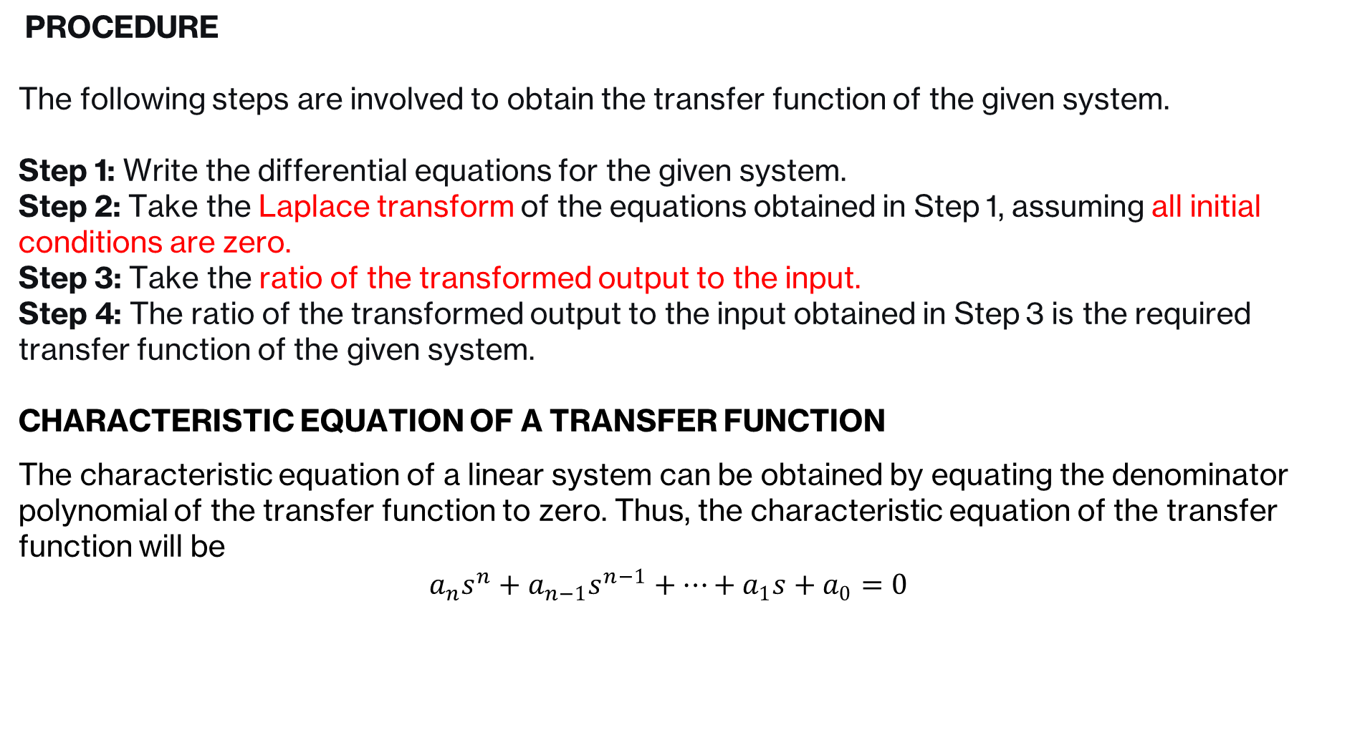
The Transfer Function: Important terms and Procedure
PROCEDURE
The following steps are involved to obtain the transfer function of the given system.
Step 1: Write the differential equations for the given system. Step 2: Take the Laplace transform of the equations obtained in Step 1, assuming all initial conditions are zero. Step 3: Take the ratio of the transformed output to the input. Step 4: The ratio of the transformed output to the input obtained in Step 3 is the required transfer function of the given system.
CHARACTERISTIC EQUATION OF A TRANSFER FUNCTION
The characteristic equation of a linear system can be obtained by equating the denominator polynomial of the transfer function to zero. Thus, the characteristic equation of the transfer function will be
$$\begin{matrix} & a_{n}s^{n}+a_{n−1}s^{n−1}+…+a_{1}s+a_{0}=0 & & \end{matrix}$$

Slide 6
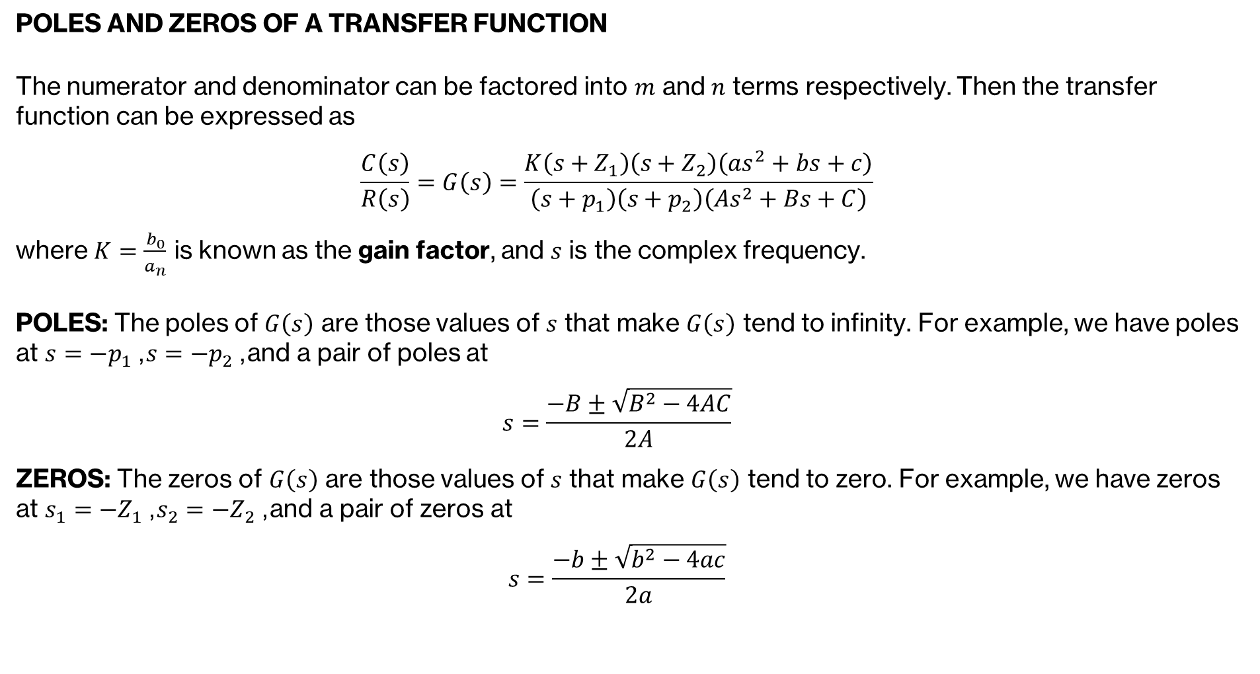
The Transfer Function: Poles and Zeros
POLES AND ZEROS OF A TRANSFER FUNCTION
The numerator and denominator can be factored into $m$ and $n$ terms respectively. Then the transfer function can be expressed as
$$\begin{matrix} & \frac{C\left(s\right)}{R\left(s\right)}=G\left(s\right)=\frac{K\left(s+Z_{1}\right)\left(s+Z_{2}\right)\left(as^{2}+bs+c\right)}{\left(s+p_{1}\right)\left(s+p_{2}\right)\left(As^{2}+Bs+C\right)} & & \end{matrix}$$
where $K=\frac{b_{0}}{a_{n}}$ is known as the gain factor, and $s$ is the complex frequency.
POLES: The poles of $G\left(s\right)$ are those values of $s$ that make $G\left(s\right)$ tend to infinity. For example, we have poles at $s=−p_{1}$, $s=−p_{2}$, and a pair of poles at
$$\begin{matrix} & s=\frac{−B±\sqrt{B^{2}−4AC}}{2A} & & \end{matrix}$$
ZEROS: The zeros of $G\left(s\right)$ are those values of $s$ that make $G\left(s\right)$ tend to zero. For example, we have zeros at $s_{1}=−Z_{1}$, $s_{2}=−Z_{2}$, and a pair of zeros at
$$\begin{matrix} & s=\frac{−b±\sqrt{b^{2}−4ac}}{2a} & & \end{matrix}$$

Slide 7
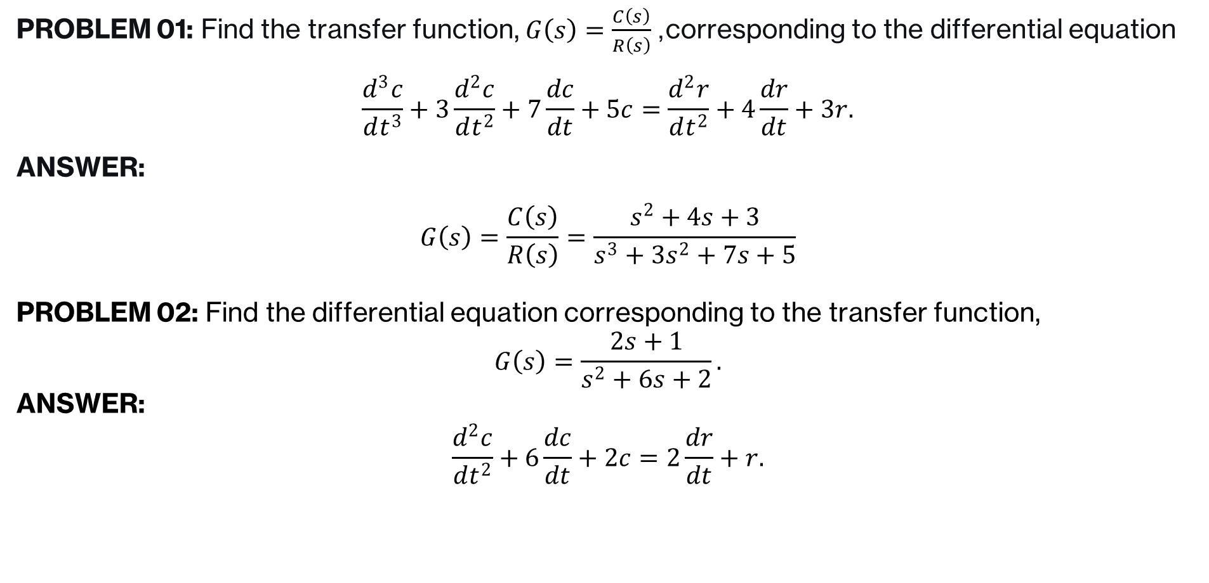
The Transfer Function: Example
PROBLEM 01: Find the transfer function, $G\left(s\right)=\frac{C\left(s\right)}{R\left(s\right)}$, corresponding to the differential equation
$$\frac{d^{3}c}{dt^{3}}+3\frac{d^{2}c}{dt^{2}}+7\frac{dc}{dt}+5c=\frac{d^{2}r}{dt^{2}}+4\frac{dr}{dt}+3r.$$
ANSWER:
$$G\left(s\right)=\frac{C\left(s\right)}{R\left(s\right)}=\frac{s^{2}+4s+3}{s^{3}+3s^{2}+7s+5}$$
PROBLEM 02: Find the differential equation corresponding to the transfer function,
$$G\left(s\right)=\frac{2s+1}{s^{2}+6s+2}.$$
ANSWER:
$$\frac{d^{2}c}{dt^{2}}+6\frac{dc}{dt}+2c=2\frac{dr}{dt}+r.$$

Slide 8
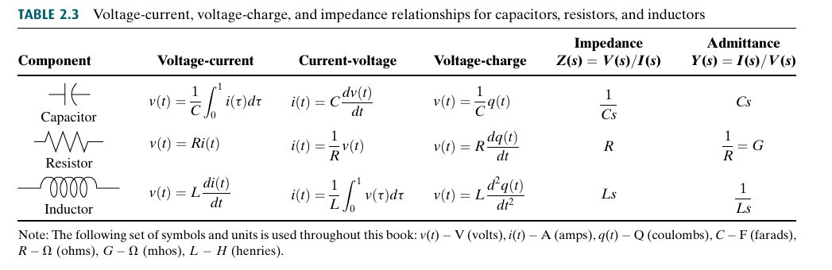
The Transfer Function: Electrical Network Transfer Functions

Slide 9
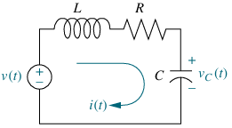
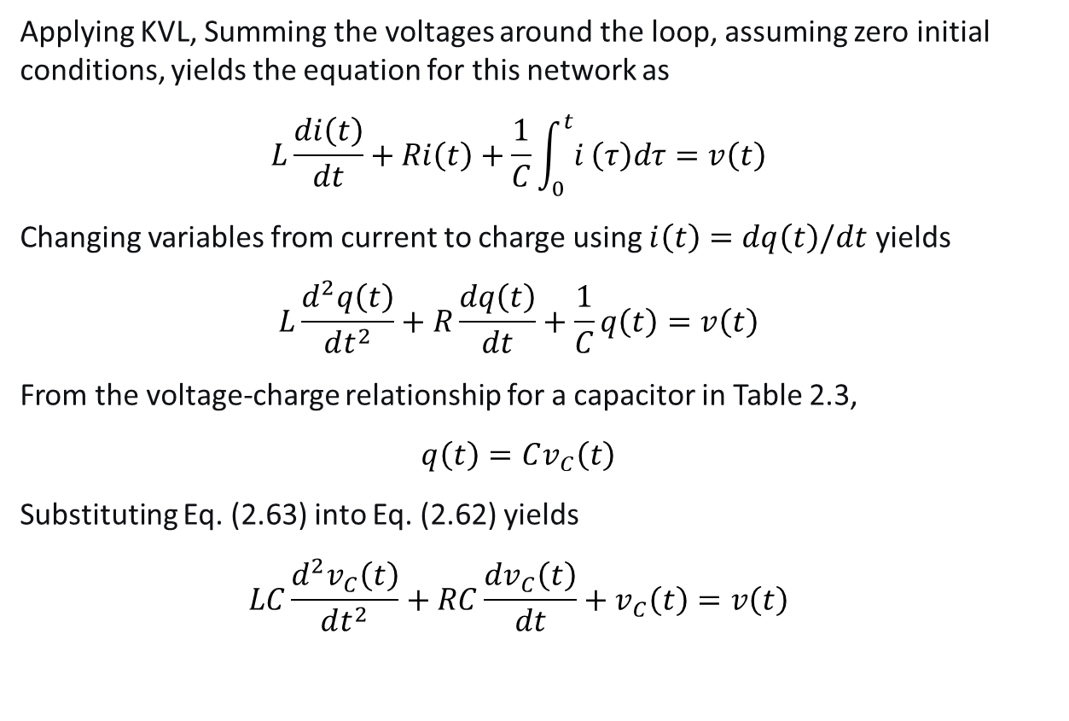
The Transfer Function: Electrical Network Transfer Functions
PROBLEM: Find the transfer function relating the capacitor voltage , V_{C}(s), to the input voltage, V(s) in Figure
Applying KVL, Summing the voltages around the loop, assuming zero initial conditions, yields the equation for this network as
$$\begin{matrix} & L\frac{di\left(t\right)}{dt}+Ri\left(t\right)+\frac{1}{C}\int_{0}^{t}{i}\left(τ\right)dτ=v\left(t\right) & & \end{matrix}$$
Changing variables from current to charge using $i\left(t\right)=dq\left(t\right)/dt$ yields
$$\begin{matrix} & L\frac{d^{2}q\left(t\right)}{dt^{2}}+R\frac{dq\left(t\right)}{dt}+\frac{1}{C}q\left(t\right)=v\left(t\right) & & \end{matrix}$$
From the voltage-charge relationship for a capacitor in Table 2.3,
$$\begin{matrix} & q\left(t\right)=Cv_{C}\left(t\right) & & \end{matrix}$$
Substituting Eq. (2.63) into Eq. (2.62) yields
$$\begin{matrix} & LC\frac{d^{2}v_{C}\left(t\right)}{dt^{2}}+RC\frac{dv_{C}\left(t\right)}{dt}+v_{C}\left(t\right)=v\left(t\right) & & \end{matrix}$$

Slide 10
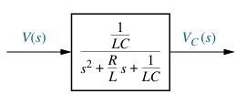
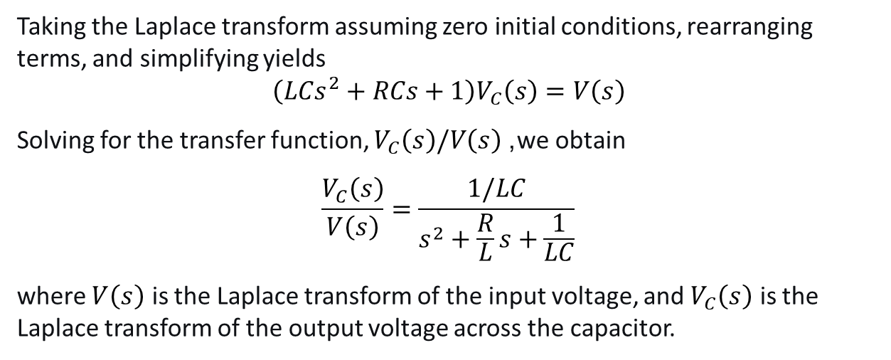
The Transfer Function: Electrical Network Transfer Functions
Taking the Laplace transform assuming zero initial conditions, rearranging terms, and simplifying yields
$$\left(LCs^{2}+RCs+1\right)V_{C}\left(s\right)=V\left(s\right)$$
Solving for the transfer function, $V_{C}\left(s\right)/V\left(s\right)$, we obtain
$$\frac{V_{C}\left(s\right)}{V\left(s\right)}=\frac{1/LC}{s^{2}+\frac{R}{L}s+\frac{1}{LC}}$$
where $V\left(s\right)$ is the Laplace transform of the input voltage, and $V_{C}\left(s\right)$ is the Laplace transform of the output voltage across the capacitor.

Slide 11
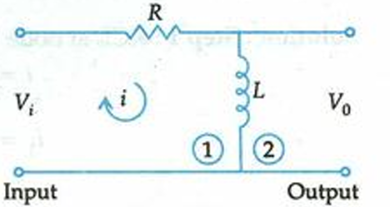

The Transfer Function: Electrical Network Transfer Functions
Problem: Find the transfer function of the given network.
Apply KVL in mesh (1)
$$\begin{matrix} & V_{i}=Ri+L\frac{di}{dt} & & \end{matrix}$$
Apply KVL in mesh (2)
$$\begin{matrix} & V_{0}=L\frac{di}{dt} & & \end{matrix}$$
Take Laplace transform of equations with the assumption that all initial conditions are zero.
$$V_{i}\left(s\right)=RI\left(s\right)+sLI\left(s\right)$$
$$\begin{matrix} & V_{0}\left(s\right)=sLI\left(s\right) & & \end{matrix}$$
Calculation of transfer function
$$\frac{V_{0}\left(s\right)}{V_{i}\left(s\right)}=\frac{sLI\left(s\right)}{\left(R+sL\right)I\left(s\right)}$$
$$\begin{matrix} & \frac{V_{0}\left(s\right)}{V_{i}\left(s\right)}=\frac{sL}{R+sL} & & \end{matrix}$$

Slide 12
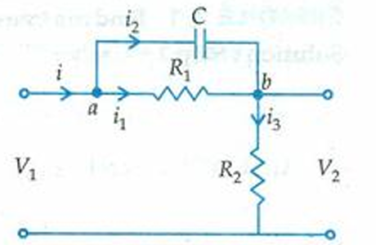
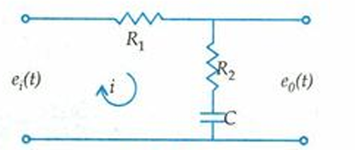
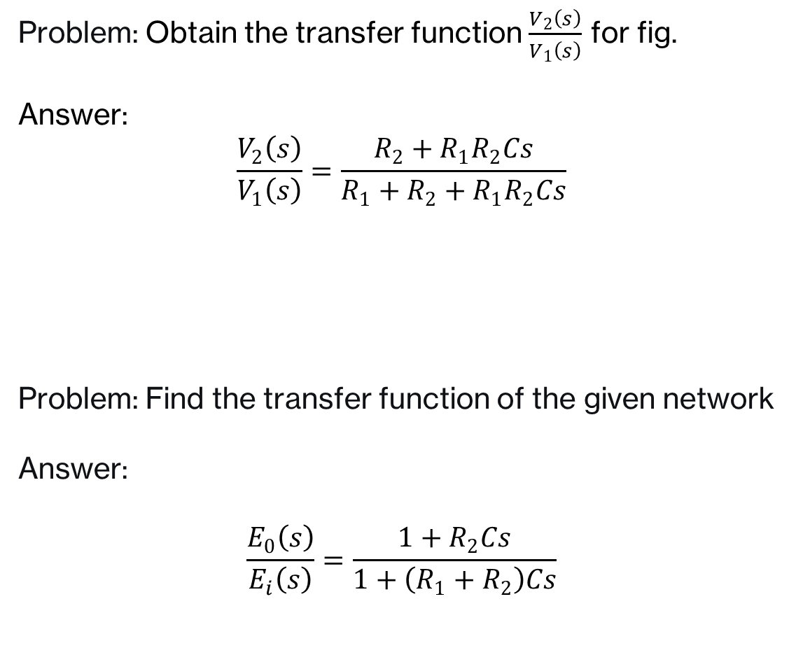
The Transfer Function: Electrical Network Transfer Functions
Problem: Obtain the transfer function $\frac{V_{2}\left(s\right)}{V_{1}\left(s\right)}$ for fig.
Answer:
$$\frac{V_{2}\left(s\right)}{V_{1}\left(s\right)}=\frac{R_{2}+R_{1}R_{2}Cs}{R_{1}+R_{2}+R_{1}R_{2}Cs}$$
Problem: Find the transfer function of the given network
Answer:
$$\frac{E_{0}\left(s\right)}{E_{i}\left(s\right)}=\frac{1+R_{2}Cs}{1+\left(R_{1}+R_{2}\right)Cs}$$

Slide 13
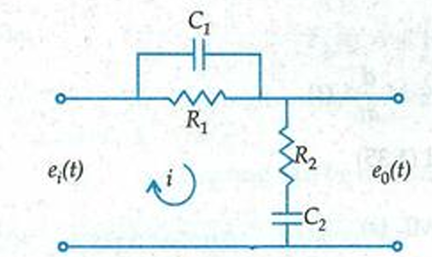
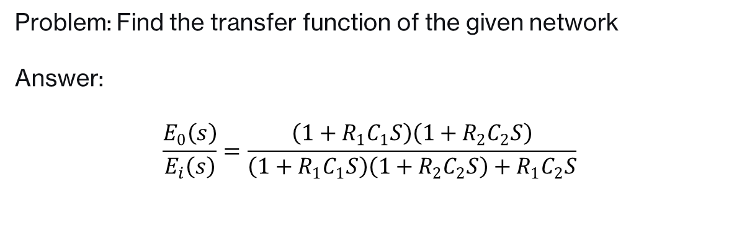
The Transfer Function: Electrical Network Transfer Functions
Problem: Find the transfer function of the given network
Answer:
$$\frac{E_{0}\left(s\right)}{E_{i}\left(s\right)}=\frac{\left(1+R_{1}C_{1}S\right)\left(1+R_{2}C_{2}S\right)}{\left(1+R_{1}C_{1}S\right)\left(1+R_{2}C_{2}S\right)+R_{1}C_{2}S}$$

